Slide 1
Probability and Regression in Python and R
Steven Rimmer Programming for Actuarial Work Working Party

Slide 2
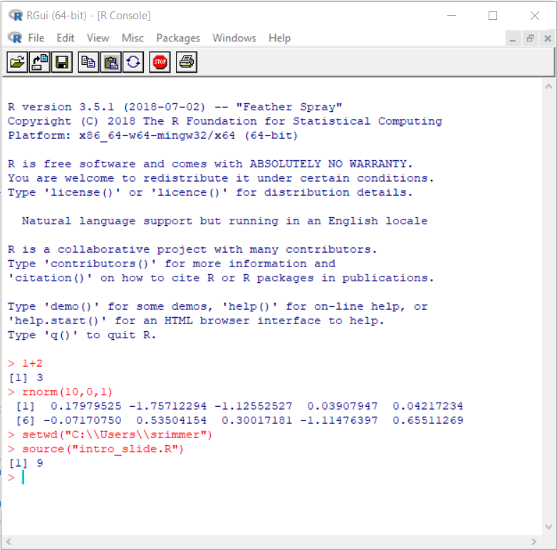
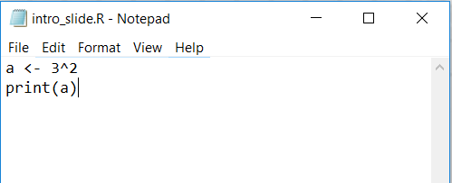
R input
R syntax can by read directly at the command-line interface, or from a separate text file, using source
More sophisticated integrated development environments (IDEs) are also available, such as RStudio.
https://www.rstudio.com/
https://www.r-project.org/

Slide 3
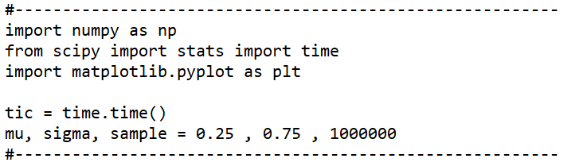
Quick example in Python: Lognormal distribution
Call the numpy library, and state that we will use np as a pseudonym
Call the stats library from scipy
Call the time library, to generate some runtime statistics
Call a plotting library (matplotlib.pyplot) and use plt as a pseudonym
From the time library, save the start time in a variable called tic
Initialise mu, sigma and sample parameters

Slide 4
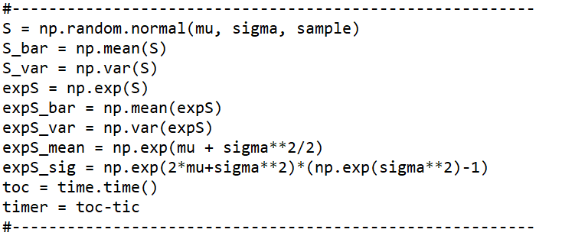
Quick example in Python: Lognormal distribution
Generate a sample of random numbers drawn from the normal distribution (np.random.normal) calling the numpy library using the pseudonym we specified (np)
Calculate the exponents (np.exp) of the random, normally distributed sample
Calculate the mean (np.mean) and variance (np.var) of the simulated numbers
Store the time taken in the timer variable

Slide 5
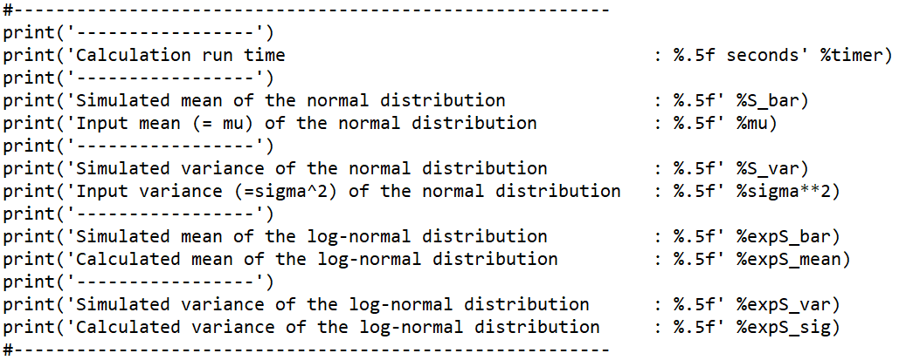
Quick example in Python: Lognormal distribution
Print the results to the screen

Slide 6
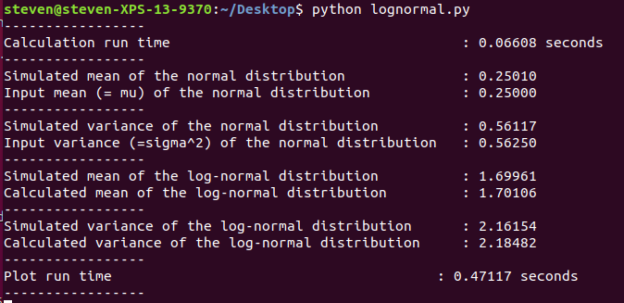
Quick example in Python: Lognormal distribution
Print the results to the screen

Slide 7
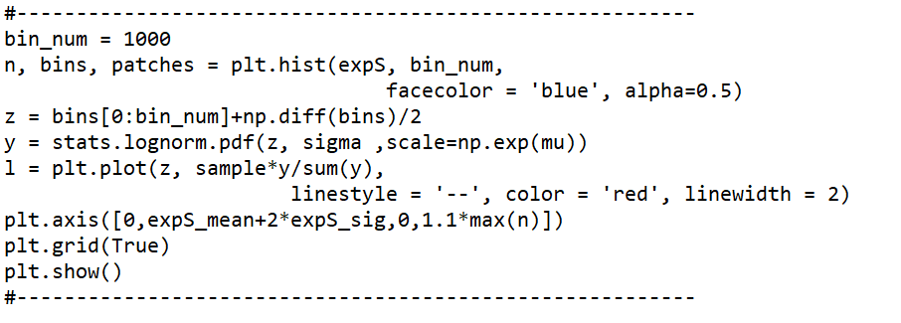
Quick example in Python: Lognormal distribution
Generate a histogram (plt.hist) calling the matplotlib.pyplot library using the pseudonym (plt) we specified
Calculate the position of the centre of the bars (z)
Call the lognormal probability density function (stats.lognorm.pdf) from the stats library (part of scipy)
Overlay the library lognormal distribution on the plot (plt.plot), using a dashed line (linestyle = ‘--’), red and a specified linewidth
Plot from 0 to 2 standard deviations over the mean on the horizontal axis (plt.axis)
Add gridlines (plt.show)

Slide 8
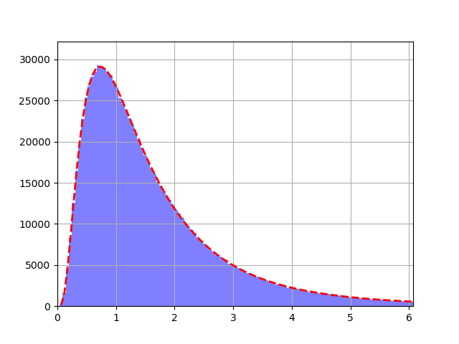
Quick example in Python: Lognormal distribution
Generate a histogram (plt.hist) calling the matplotlib.pyplot library using the pseudonym (plt) we specified
Calculate the position of the centre of the bars (z)
Call the lognormal probability density function (stats.lognorm.pdf) from the stats library (part of scipy)
Overlay the library lognormal distribution on the plot (plt.plot), using a dashed line (linestyle = ‘--’), red and a specified linewidth
Plot from 0 to 2 standard deviations over the mean on the horizontal axis (plt.axis)
Add gridlines (plt.show)

Slide 9
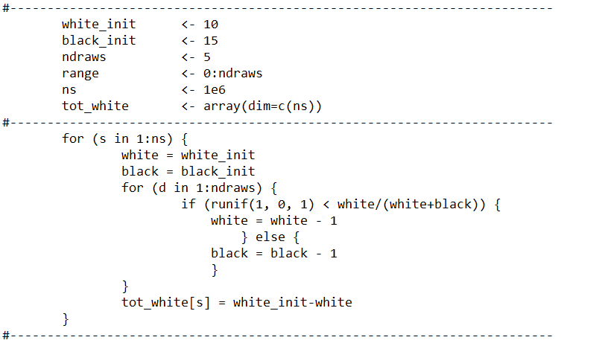
Quick example in R: Hypergeometric distribution
Simulate drawing black and white balls without replacement
Allocate specific numbers to parameters (<-)
Initialize an array with a specific dimension (dim)
Repeat a calculation over an index (for)
Perform a chunk of code when a condition is met (if…else)

Slide 10
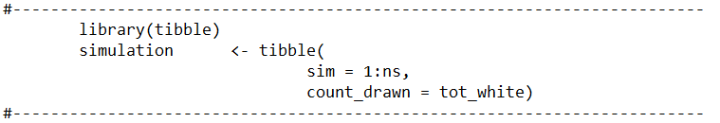
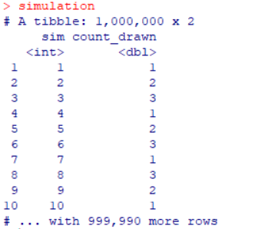
Quick example in R: Hypergeometric distribution
Call a library which helps store information in a table (tibble)
Define a column which labels each simulation (1:ns)
Define a column which stores the output from each simulation (tot_white)

Slide 11
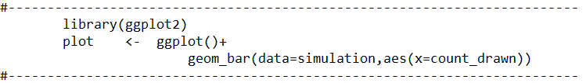
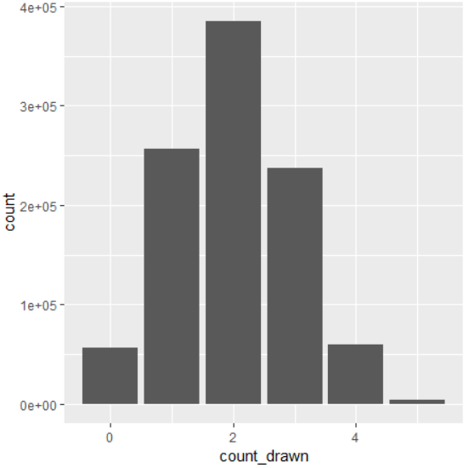
Quick example in R: Hypergeometric distribution
Call a library which supports data visualization (ggplot2)
Make a bar chart (geom_bar), plotting the count of white balls drawn on the horizontal axis (aes(x=…))

Slide 12
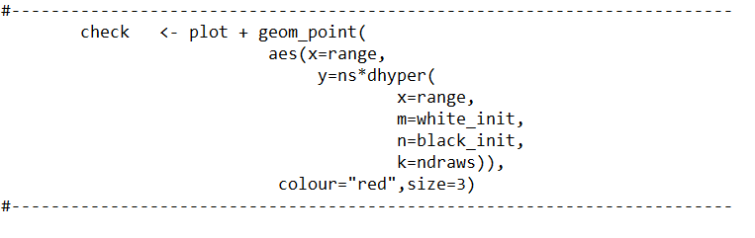
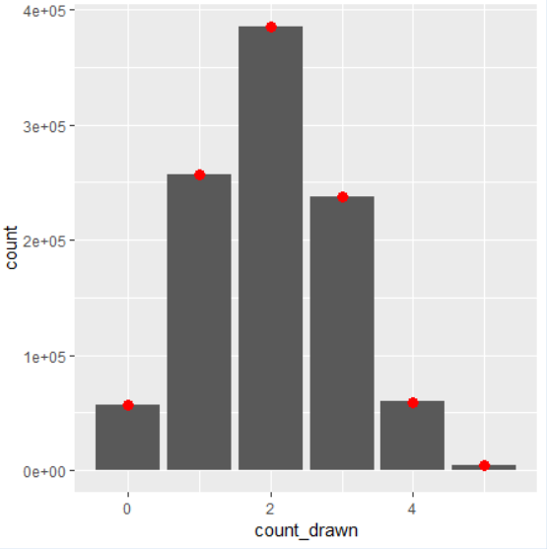
Quick example in R: Hypergeometric distribution
To the original plot, add points (geom_point), plotting the theoretical result taken from the in-built hypergeometric distribution (dhyper)

Slide 13
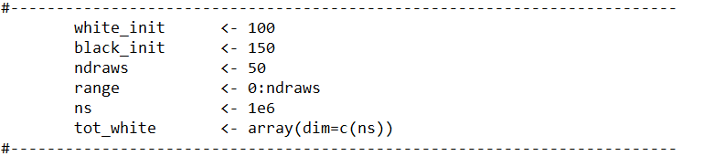
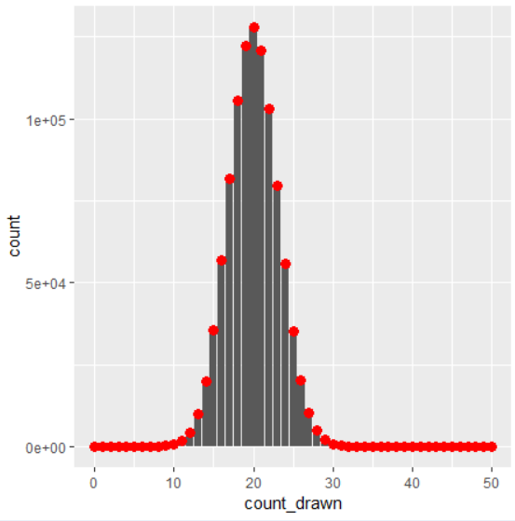
Quick example in R: Hypergeometric distribution
Re-run with different parameters

Slide 14
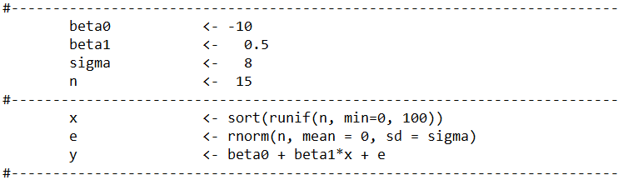

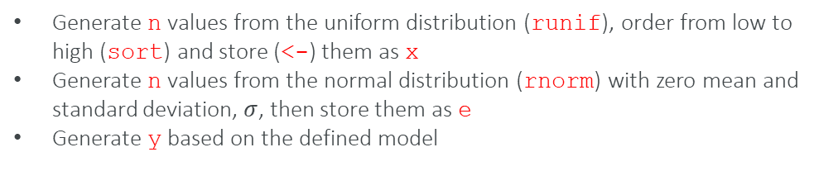

Key statistical tests ‘for free’: Simple linear model
Define a linear model:
$$y_{i}=β_{0}+β_{1}x_{i}+ε_{i}$$
$$ε_{i}\sim N\left(0,σ^{2}\right)$$
where:
Generate n values from the uniform distribution (runif), order from low to high (sort) and store (<-) them as x
Generate n values from the normal distribution (rnorm) with zero mean and standard deviation, $σ$, then store them as e
Generate y based on the defined model

Slide 15
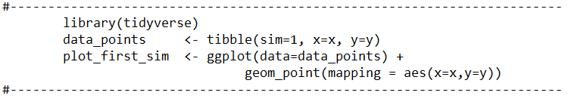
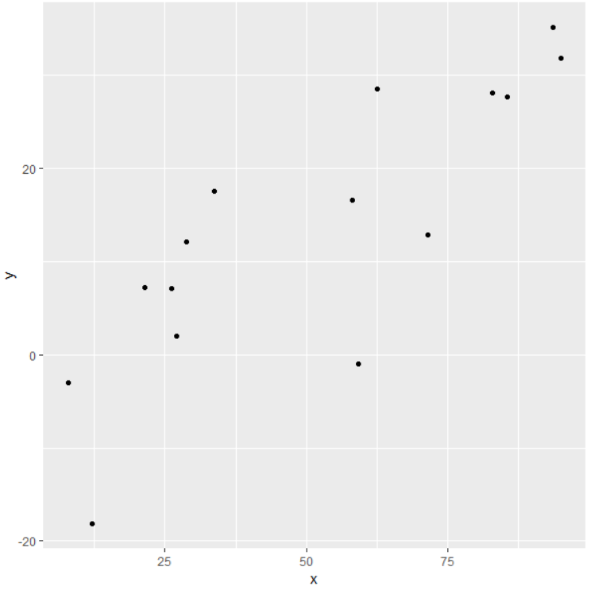
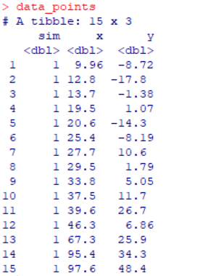
Key statistical tests ‘for free’: Simple linear model
Gather the n pairs of x and y into a table (tibble), called data_points adding a new variable (sim) to label this as the first simulation.
Plot the data (ggplot) as a scatterplot (geom_point) showing x on the horizontal axis and y on the vertical axis.
The tibble and ggplot packages are part of a collection called the tidyverse , which is called into the before use.

Slide 16
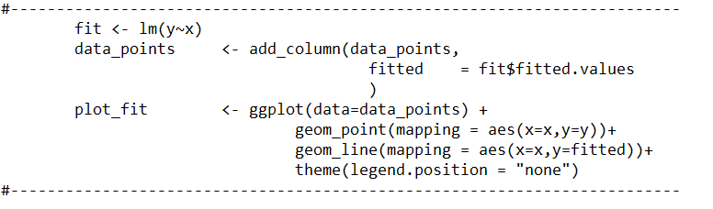
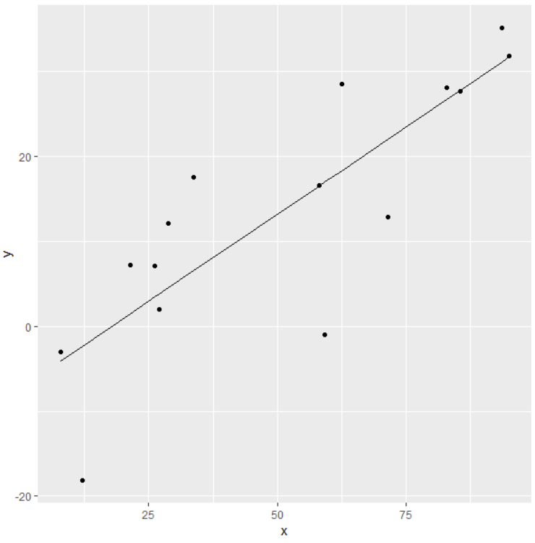
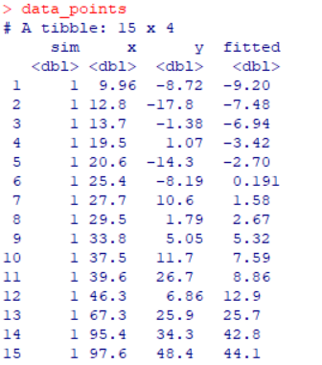
Key statistical tests ‘for free’: Simple linear model
Fit a linear model (lm) with x as a linear covariate for the response y and store the results in an object called fit
Add a column labelled fitted to data_points, which stores the resulting values from the linear fit (fit$fitted.values)
Plot the fitted values as a line (geom_line) showing x on the horizontal axis and fitted on the vertical axis.

Slide 17
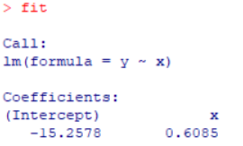
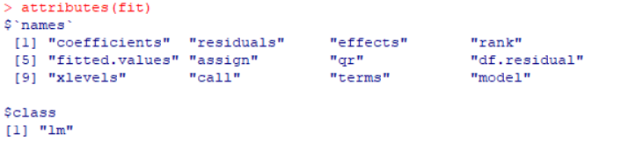

Key statistical tests ‘for free’: Simple linear model
Properties of fit object
The results of fitting the linear model were stored in an object called fit
This object has a number of attributes which are referenced via the $ symbol
On the previous slide the fitted values were added to data_points using the fit$fitted.values attribute
Using the fit$coefficients attribute, the estimated intercept and slope can be referenced.
The fit$residuals attribute provides the difference between the actual and fitted result.

Slide 18
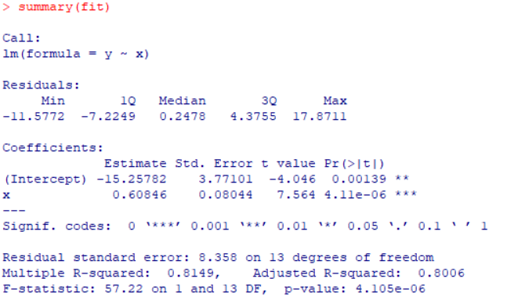
Key statistical tests ‘for free’: Simple linear model
Output from summary(fit)
Reports the model which was used
Reports the estimated intercept and coefficient of each covariate (the slope)
The estimated standard error around that estimate
The t-value
The corresponding p-value
Significant factors highlighted using ‘***’
The residual standard error
R-squared
The F-statistic
(1)
(2)
(3)
(4)
(5)
(6)
(7)
(8)
(9)

Slide 19
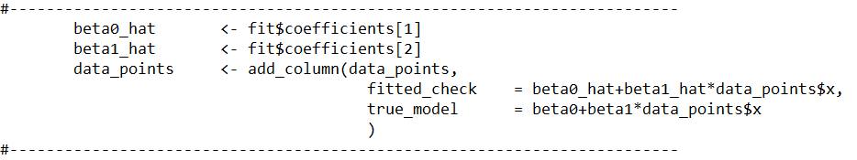
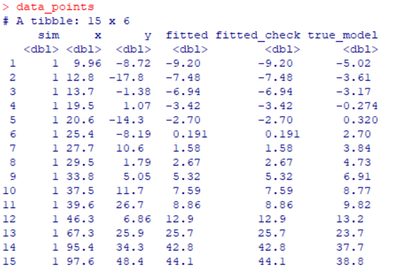
Key statistical tests ‘for free’: Simple linear model
Using the fit$coefficients attribute, can confirm that the output matches the fit$fitted.values attribute
In addition, the values associated with the true underlying model can be added to the data_points table

Slide 20
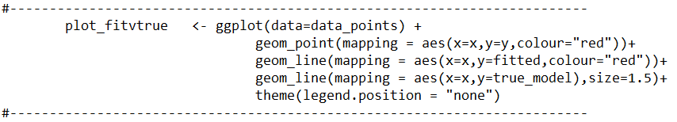
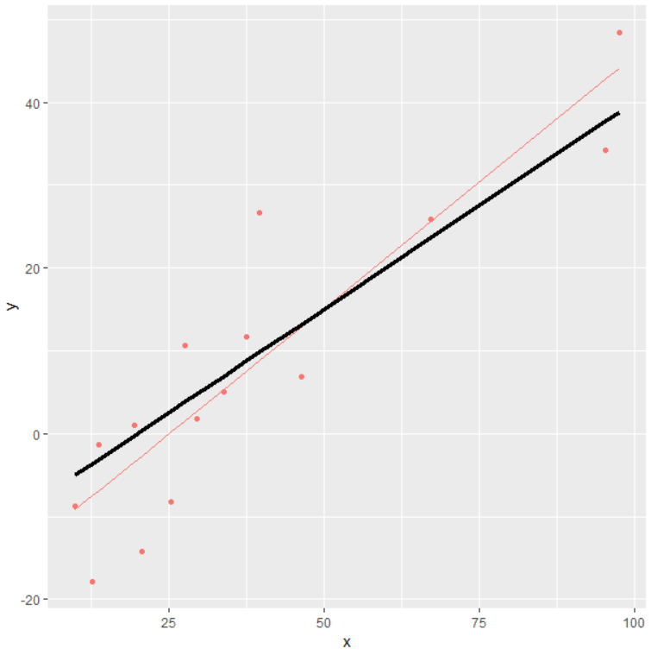
Key statistical tests ‘for free’: Simple linear model
Plot the true model (in black) alongside the fit for this particular realization (in red)

Slide 21
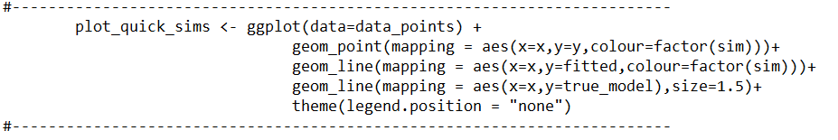
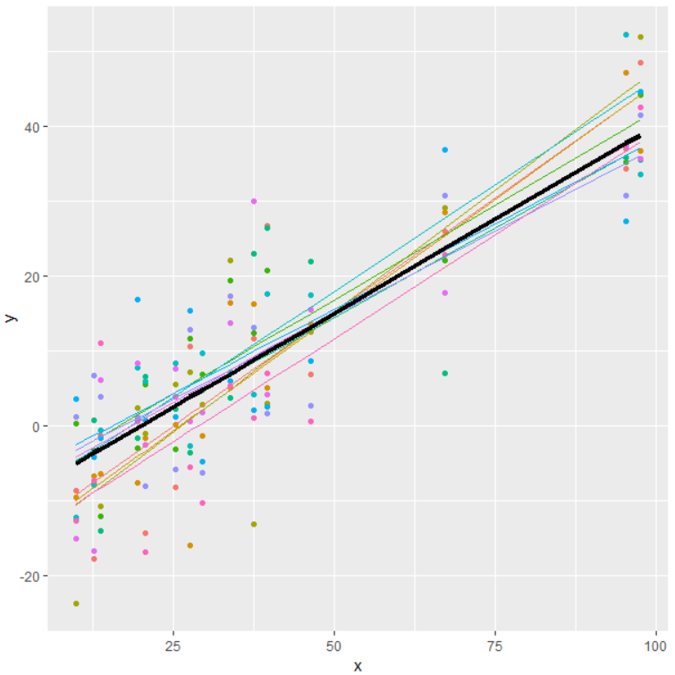
Key statistical tests ‘for free’: Simple linear model
Plot the true model (in black) alongside the fit for this particular realization (in red)
Add multiple realizations from the same model (in colours)

Slide 22
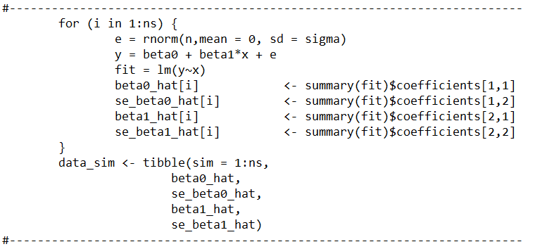
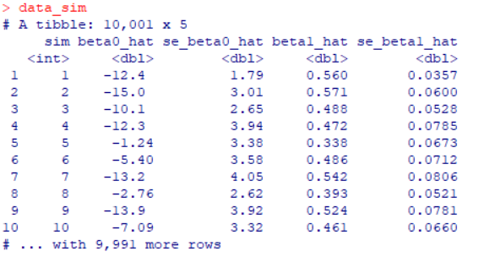
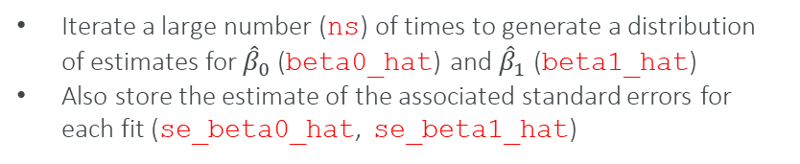
Key statistical tests ‘for free’: Simple linear model
Iterate a large number (ns) of times to generate a distribution of estimates for ${\hat{β}}_{0}$ (beta0_hat) and ${\hat{β}}_{1}$ (beta1_hat)
Also store the estimate of the associated standard errors for each fit (se_beta0_hat, se_beta1_hat)

Slide 23
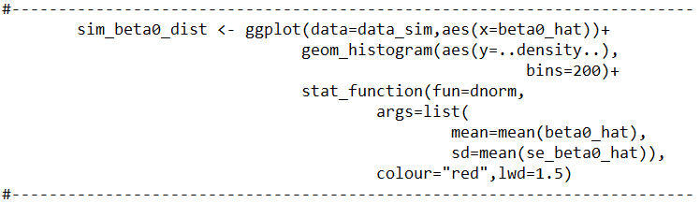
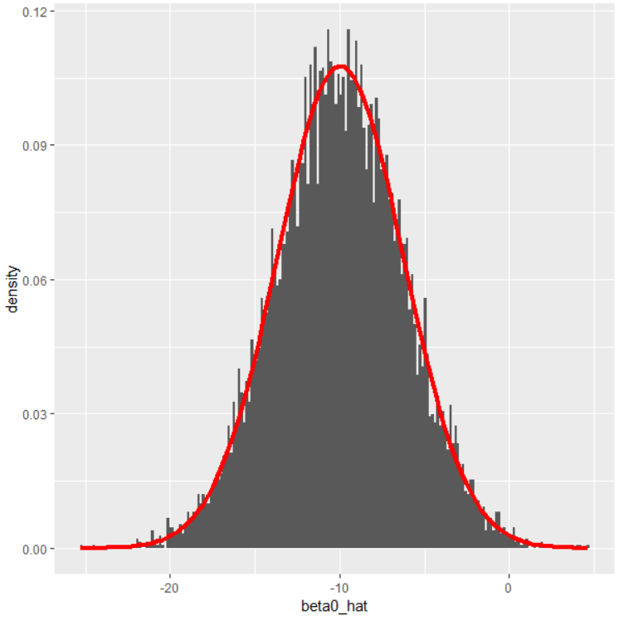
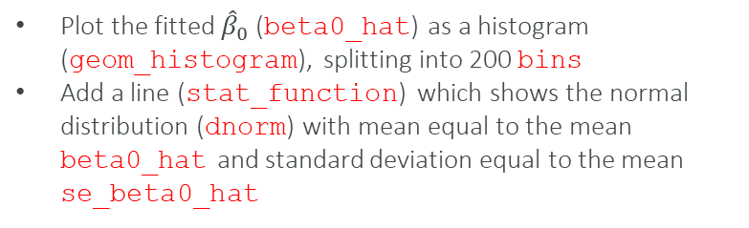
Key statistical tests ‘for free’: Simple linear model
Plot the fitted ${\hat{β}}_{0}$ (beta0_hat) as a histogram (geom_histogram), splitting into 200 bins
Add a line (stat_function) which shows the normal distribution (dnorm) with mean equal to the mean beta0_hat and standard deviation equal to the mean se_beta0_hat

Slide 24
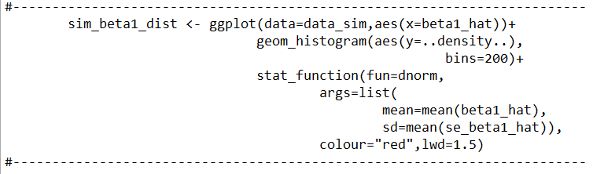
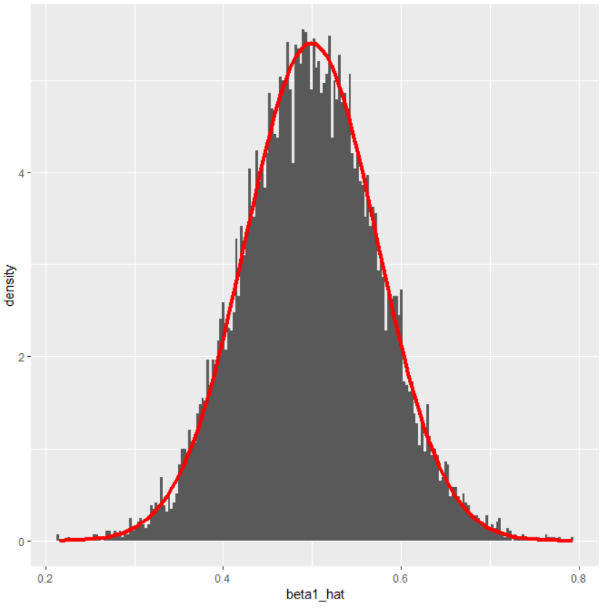
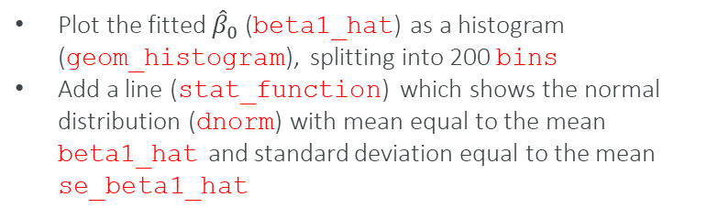
Key statistical tests ‘for free’: Simple linear model
Plot the fitted ${\hat{β}}_{0}$ (beta1_hat) as a histogram (geom_histogram), splitting into 200 bins
Add a line (stat_function) which shows the normal distribution (dnorm) with mean equal to the mean beta1_hat and standard deviation equal to the mean se_beta1_hat

Slide 25
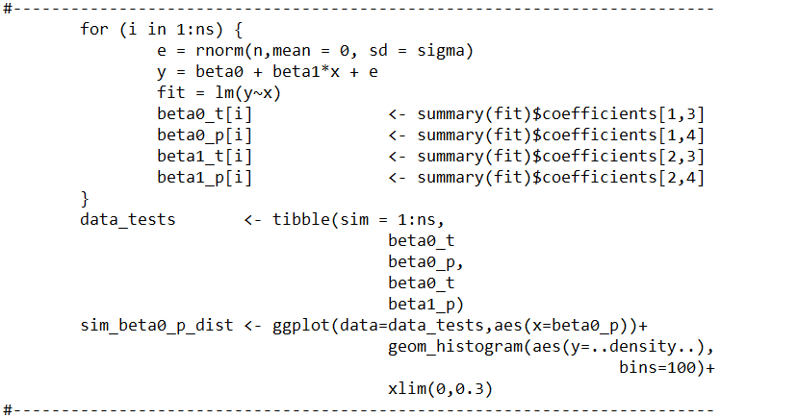
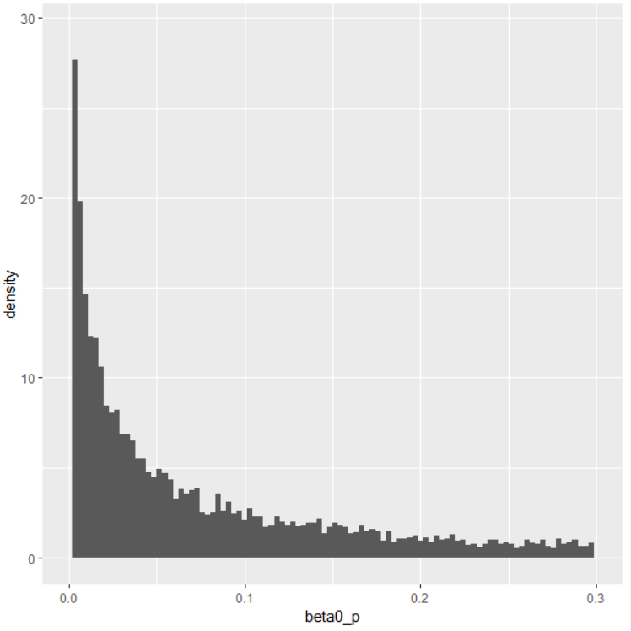
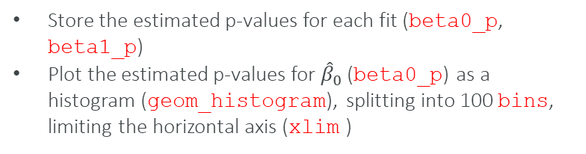
Key statistical tests ‘for free’: Simple linear model
Store the estimated p-values for each fit (beta0_p, beta1_p)
Plot the estimated p-values for ${\hat{β}}_{0}$ (beta0_p) as a histogram (geom_histogram), splitting into 100 bins, limiting the horizontal axis (xlim )

Slide 26
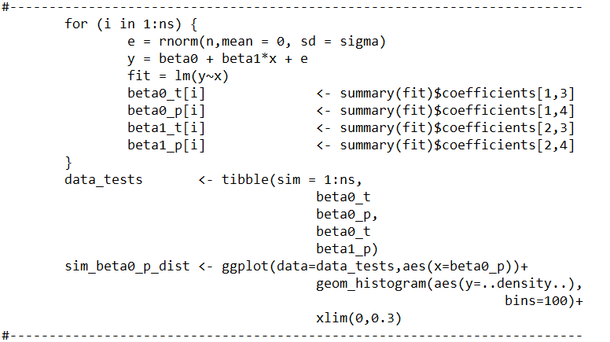
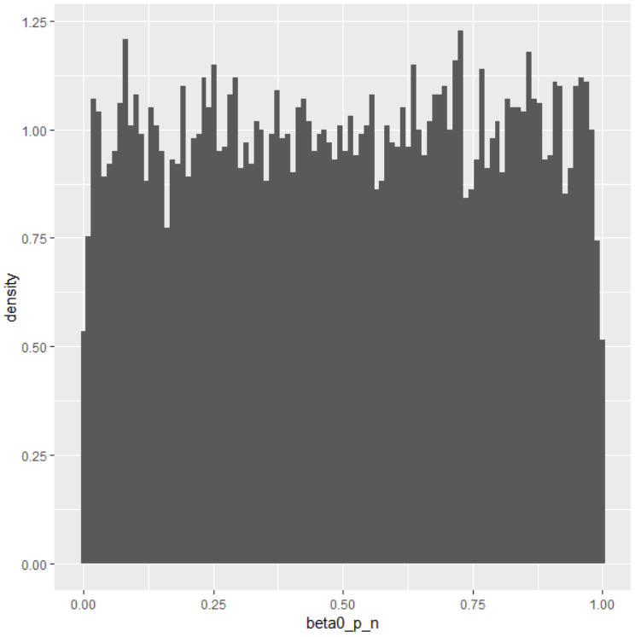
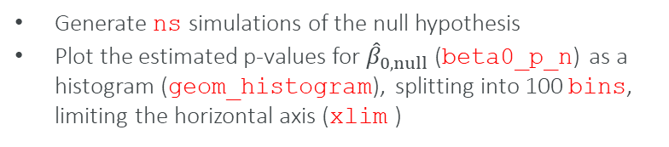
Key statistical tests ‘for free’: Simple linear model
Generate ns simulations of the null hypothesis
Plot the estimated p-values for ${\hat{β}}_{0,null}$ (beta0_p_n) as a histogram (geom_histogram), splitting into 100 bins, limiting the horizontal axis (xlim )

Slide 27
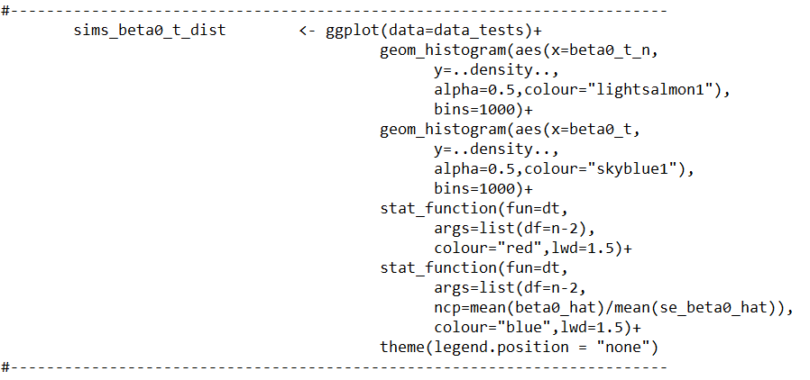


Key statistical tests ‘for free’: Simple linear model
Plot the estimated t-values for ${\hat{β}}_{0}$ and ${\hat{β}}_{0,null}$ (beta0_t, beta0_t_n) as a histogram (geom_histogram) and overlay the t-distribution (fun=dt)

Slide 28


Key statistical tests ‘for free’: Simple linear model
Using the ggplot_build command to values which build up the histogram (or any plot) can be accessed.

Slide 29


Key statistical tests ‘for free’: Simple linear model
Determining the approximate area under the null distribution curve c (cumsum) and the probability density of the observed distribution the distribution of p-values seen before can be estimated.

Slide 30




Wide range of libraries: Generalized linear model
$\overset{⃑}{Y}= g^{−1}\left(\underline{X}∙\overset{⃑}{β}+\overset{⃑}{ξ}\right)+\overset{⃑}{ε}$
Initialize a dummy population, defined by factors, X, A and B.
X runs from 1 to 31 (eg an age index)
A and B are categorical (eg gender, high pension v low pension)
Define systematic component to depend on X and A, but not B.
Simulate poisson events (eg deaths) from the library (rpois)
$\left(\begin{matrix}D_{1} \\ D_{2} \\ \begin{aligned}D_{3} \\ ⋮\end{aligned}\end{matrix}\right)=exp\left\{\left(\begin{matrix}1 & 1 & 0 & … \\ 1 & 2 & 0 & … \\ 1 & 3 & 0 & … \\ ⋮ & ⋮ & ⋮ & ⋱\end{matrix}\right)\left(\begin{matrix}β_{0} \\ β_{X} \\ \begin{aligned}β_{A} \\ ⋮\end{aligned}\end{matrix}\right)+\left(\begin{matrix}{log⁡(E}_{1}) \\ {log⁡(E}_{2}) \\ \begin{aligned}{log⁡(E}_{3}) \\ ⋮\end{aligned}\end{matrix}\right)\right\}$+$\left(\begin{matrix}ε_{1} \\ ε_{2} \\ \begin{aligned}ε_{3} \\ ⋮\end{aligned}\end{matrix}\right)$

Slide 31



Wide range of libraries: Generalized linear model
Running the simulation to generate a large number of data points, the estimated $\hat{β}$ match the input parameters

Slide 32
Questions
Comments
The views expressed in this [publication/presentation] are those of invited contributors and not necessarily those of the IFoA. The IFoA do not endorse any of the views stated, nor any claims or representations made in this [publication/presentation] and accept no responsibility or liability to any person for loss or damage suffered as a consequence of their placing reliance upon any view, claim or representation made in this [publication/presentation].
The information and expressions of opinion contained in this publication are not intended to be a comprehensive study, nor to provide actuarial advice or advice of any nature and should not be treated as a substitute for specific advice concerning individual situations. On no account may any part of this [publication/presentation] be reproduced without the written permission of the IFoA [or authors, in the case of non-IFoA research].

